Slide 1

Subgame Perfection
Chris Kiekintveld

Slide 2
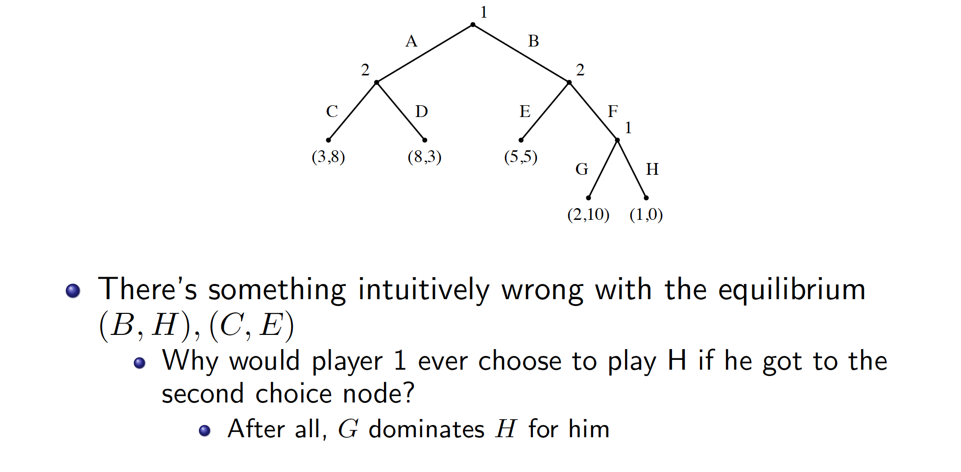
Subgame Perfection

Slide 3
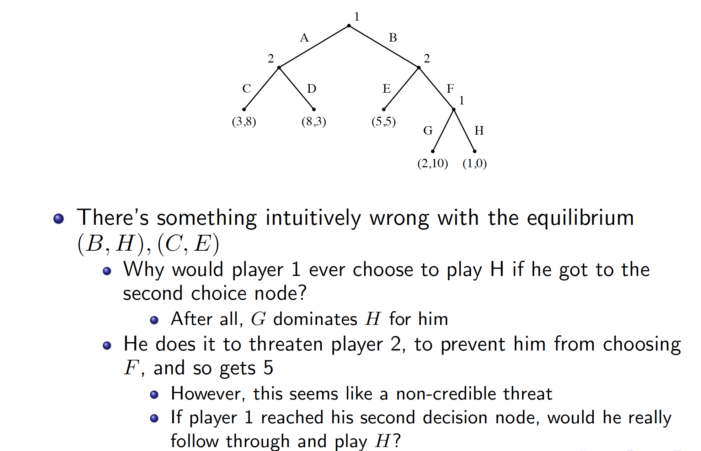
Subgame Perfection

Slide 4
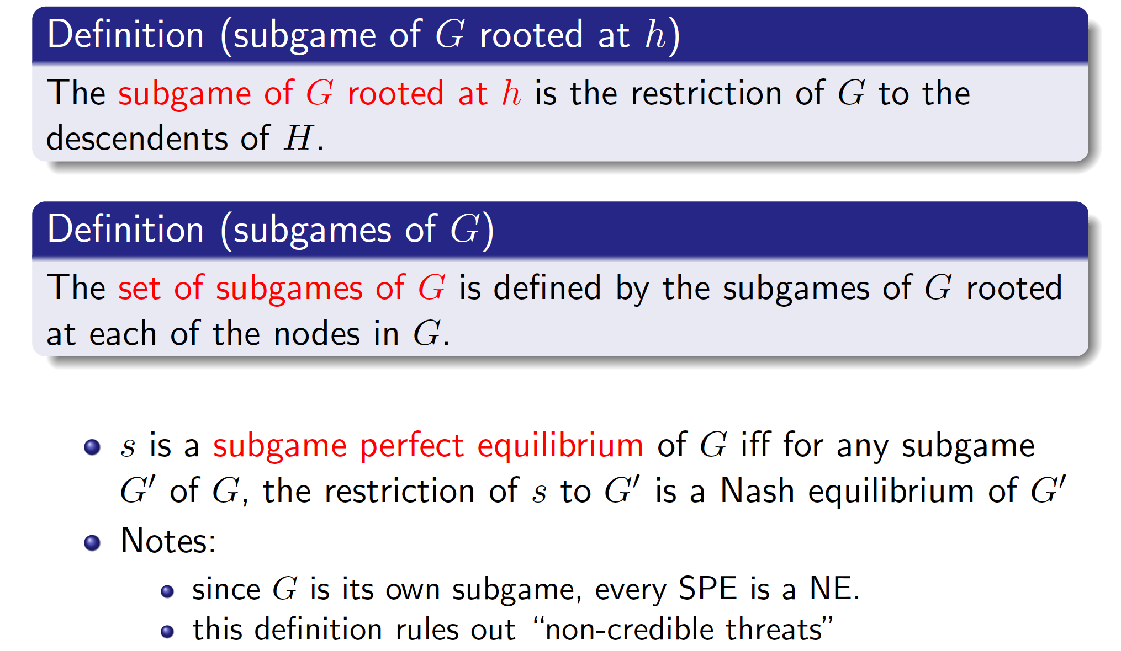
Formal Definition

Slide 5
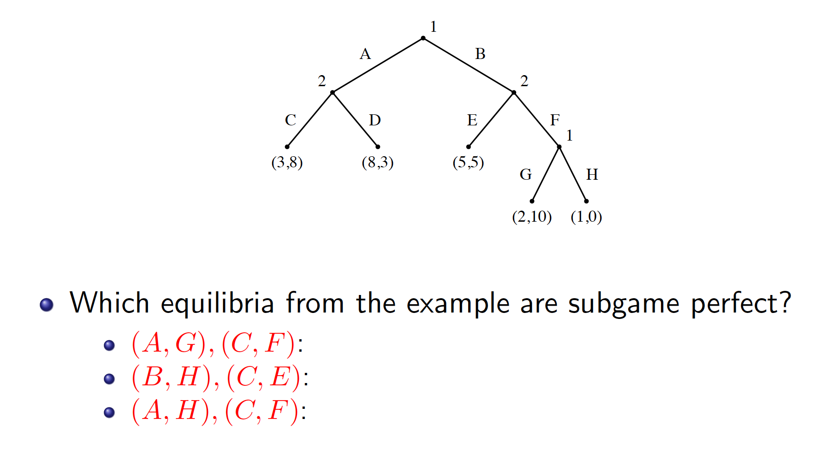
Which Equilibria are Subgame Perfect?

Slide 6
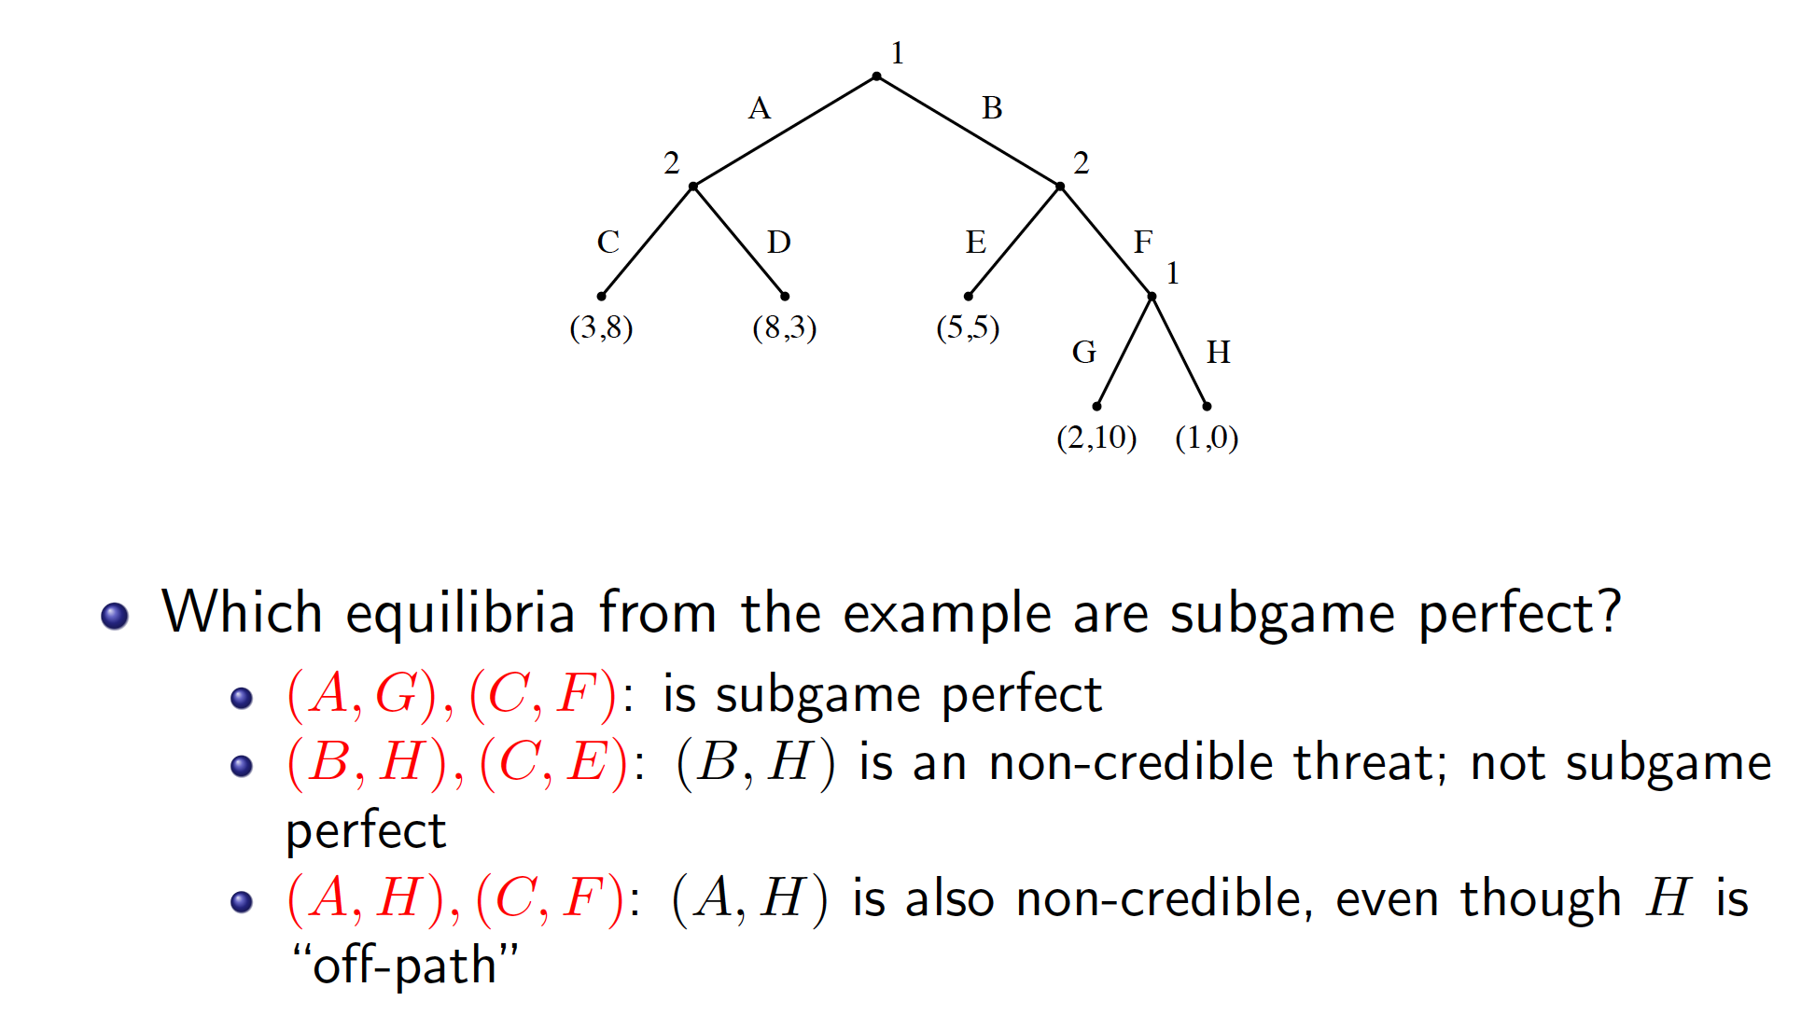
Which Equilibria are Subgame Perfect?

Slide 7
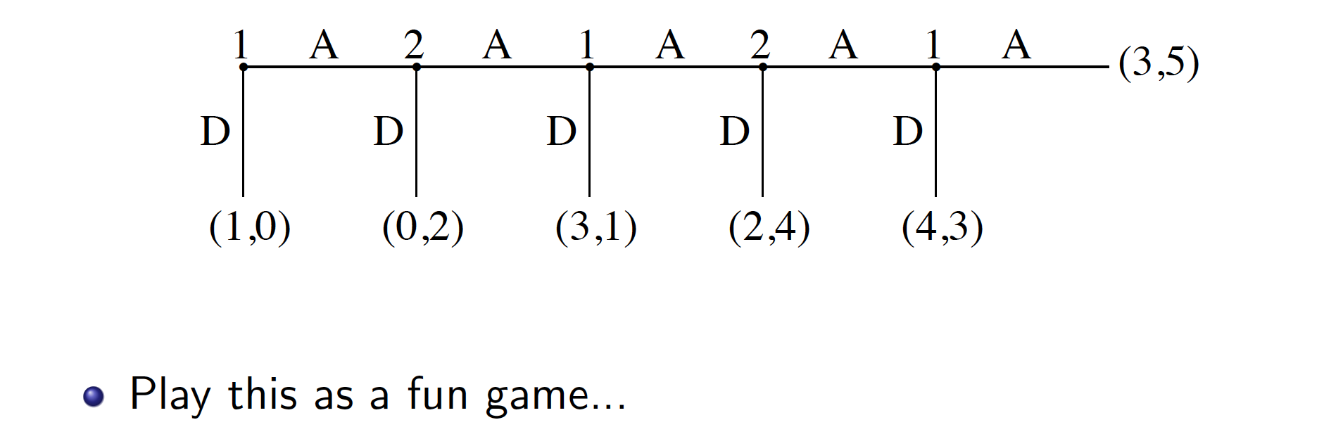
Centipede Game

Slide 8
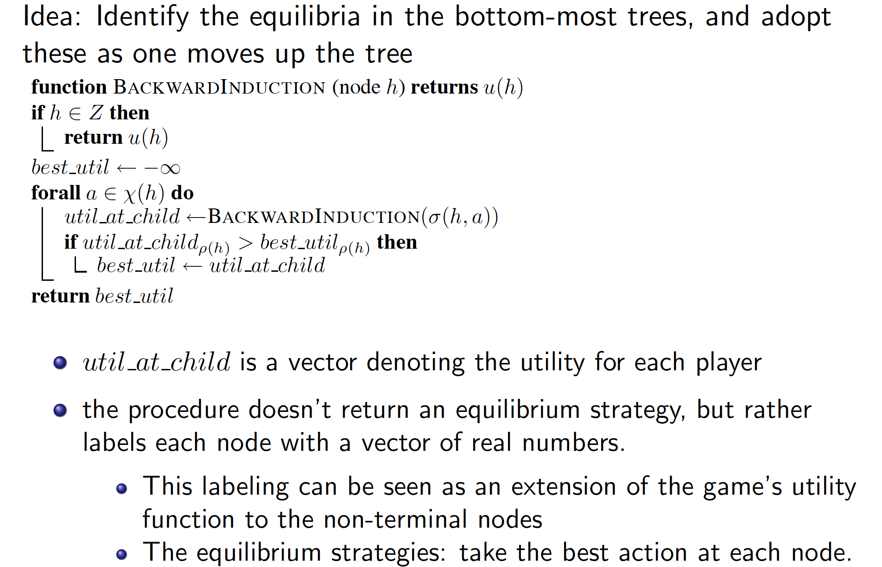
Computing Subgame Perfect Equilibrium

Slide 9
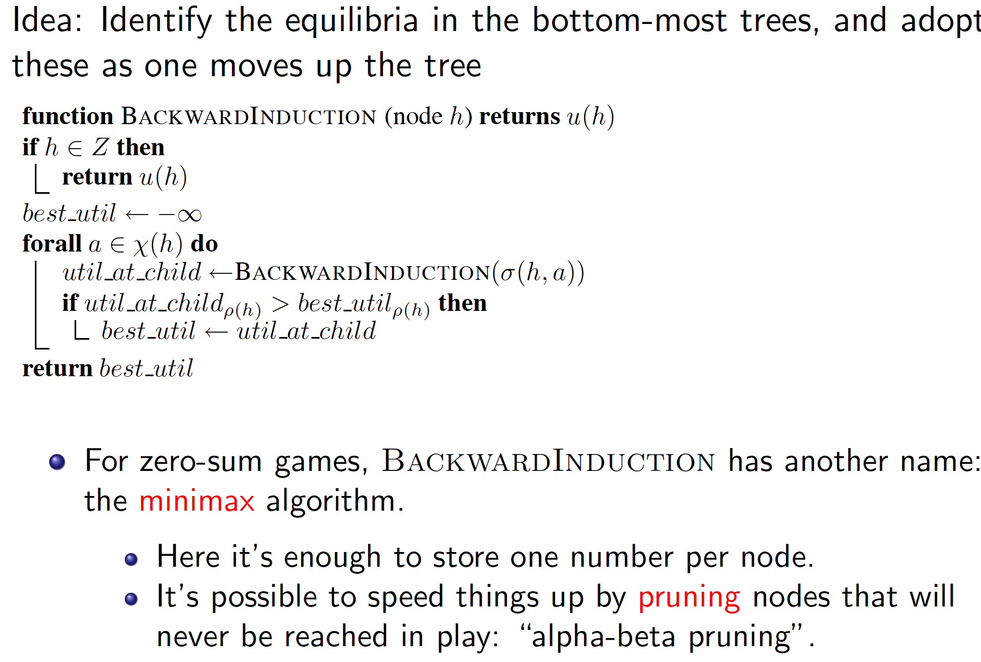
Computing Subgame Perfect Equilibrium

Slide 10
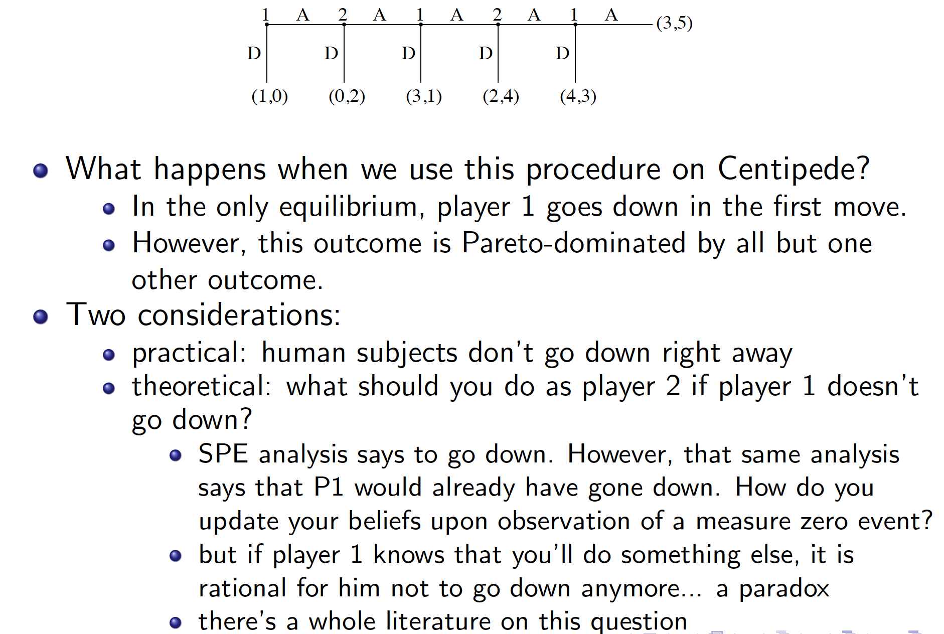
Backwards Induction

